Slide 1
PEOPLE: THE NEGLECTED FACTOR IN CYBER SECURITY
Mohammed Shafiul Alam Khan
PhD (Information Security, RHUL, UK)
Professor, Institute of Information Technology (IIT)
University of Dhaka
Email: shafiul@du.ac.bd

Slide 2
Outline
Overview of a Security System
Different Class of Security Attacks
What to Do and What Not to Do
Conclusion

Slide 3
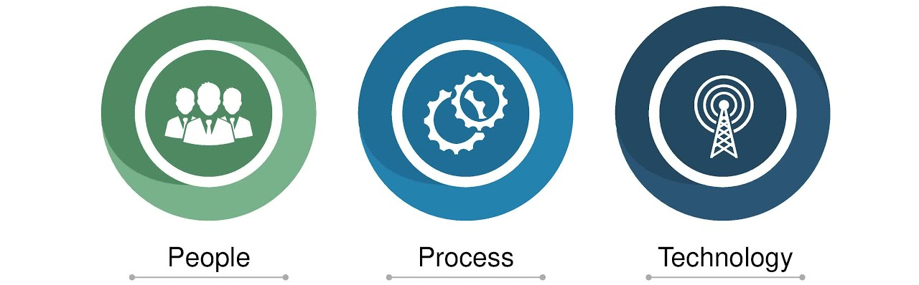
Overview of a Security System
All three of these combined, protects any system from threats and attacks.

Slide 4

The People
People are the weakest link to security programs (most neglected factor).
Technology and processes are mostly reliable.
Human being are unpredictable, susceptible to attacks and can be stressed into doing something out of protocol.
Human error is still the greatest cause of data breaches and security failures (Source: Helpnet Security).
A single human error is enough to bring down the whole system
4

Slide 5
Security Attacks

Slide 6
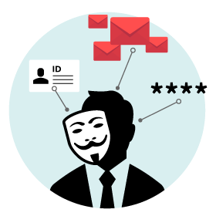
Social Engineering Attacks
Social engineering attack uses psychological manipulation to trick users into making security mistakes or giving away sensitive information.
Attacker needs valid data to trick users.
One need to know how attacker collect data for social engineers attacks.
Notes:
https://digitalguardian.com/blog/social-engineering-attacks-common-techniques-how-prevent-attack- ei website e easy kore lekha ase

Slide 7

Gathering Information for Social Engineering
Attacks

Slide 8

Gathering Information
A staggering wealth of information exists in online databases, public records, and social media sites, and in many cases, this data is free for the taking.
Human intelligence is data gathered by talking to people.
Google hacking

Slide 9

Different
Social Engineering
Attacks
Notes:
https://digitalguardian.com/blog/social-engineering-attacks-common-techniques-how-prevent-attack- ei website e easy kore lekha ase

Slide 10
Pretexting Attack
Attackers use information to pretend to be a trusted entity to a specific user.
Create scenarios where the user is convinced to trust them
Finally, give up sensitive information and perform activities that render the user vulnerable.
Example
Assume someone calls an employee and pretends to be someone in power, such as the CEO or on the information technology team.
The attacker convinces the victim that the scenario is true and collects information that is sought.
10

Slide 11
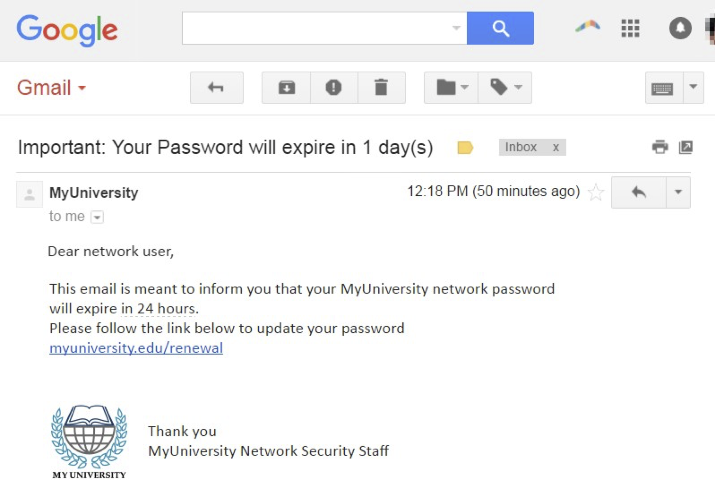
Phishing Attack
Attacker uses electronic communications such as email, texting, or phone calls to convince the target to click a malicious link.
Goal is to collect the target’s personal information or install malware on their system.
11

Slide 12
Phishing Attack – An Entry Point for Attacker
Phishing accounts for 37% of all cyber-attacks directed toward businesses.
More than 90% of successful attacks against businesses originate from phishing.
37.9% of Untrained Users fail Phishing tests
74% of all Phishing websites use HTTPS (Secured HTTP) – Padlock cannot safe you!
94% of Malware is delivered via email (using Phishing attack)
A new Phishing site launches every 20 seconds
12
Notes:
HTTPS and the Padlock

Slide 13
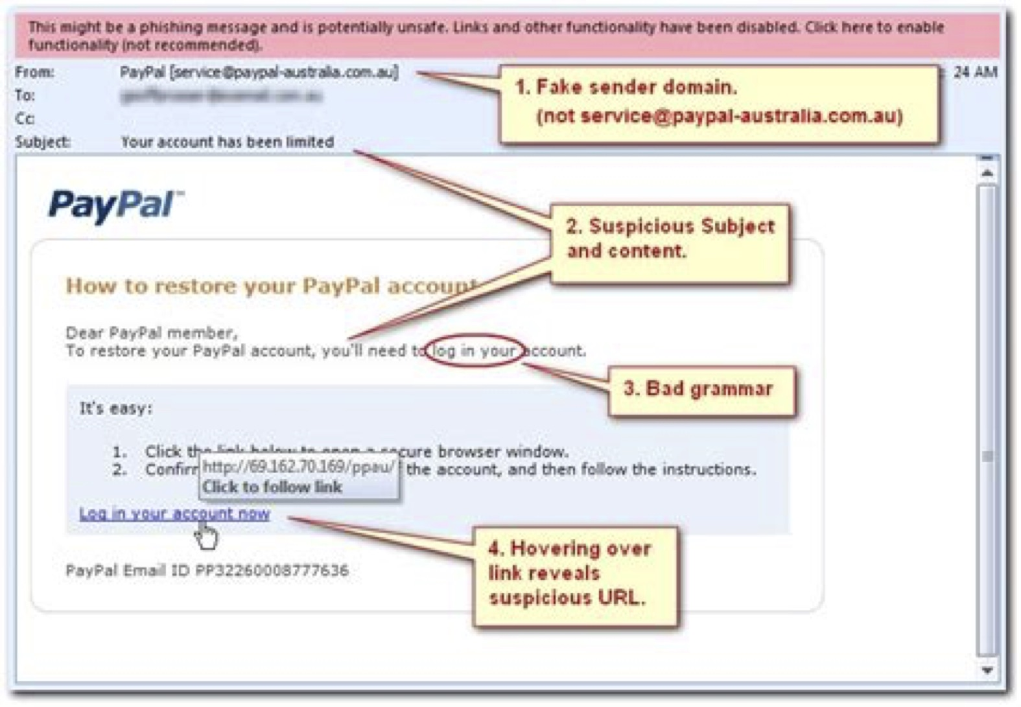
How to Tackle Phishing Attack
Don’t click any links on an email unless you can guarantee who its from
Look details of such an email carefully
Use a trusted method of contacting via a phone number, or website
Mark the email as spam
Using updated browser
13

Slide 14

Vishing and Smishing Attack
Vishing and Smishing are similar to phishing.
Vishing is convincing a target to give access to computer over telephone.
Smishing is sending fraudulent links over SMS to bait a victim.

Slide 15
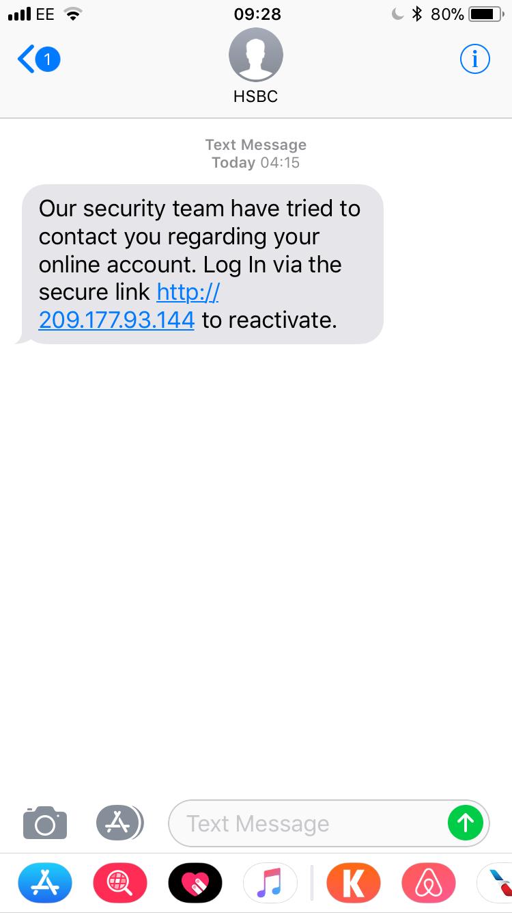
How to Tackle Vishing and Smishing Attack
Avoid responding to text messages from strangers. If there are any links, images or other attachments in such messages, do not tap them.
Use apps like Truecaller to identify unknown callers.
Never give out sensitive data like bank details, passwords and credit card details over phone calls or messages unless the recipients are people you’re familiar with.

Slide 16
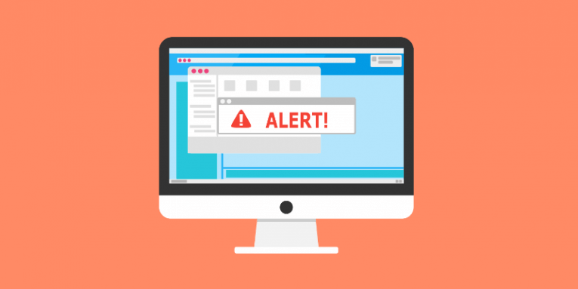
Scareware
Attackers use to scare people into downloading malicious software.
For example, rogue scareware or fake software include Advanced Cleaner, System Defender, and Ultimate Cleaner.
Prevention
Use software from trusted companies.
Avoid popups and use adblocker.

Slide 17

Baiting
Baiting means offering something enticing or curious in front of the victim to lure them into a social engineering trap.
For example, encouraging a person to provide bKash PIN in exchange for free money.
Prevention
Staying vigilant about suspicious offers.
Conduct organized simulated attacks to check employee awareness.

Slide 18

Quid Pro Quo
Quid Pro Quo means something for something.
Quid pro quo usually provides sensitive information in exchange for a service.
For example, social media like Facebook offers free services in exchange for a ton of user data.
Prevention
Reading privacy policies and terms and conditions before signing up for a free service.
User Awareness.
Remembering any free service is not always free

Slide 19
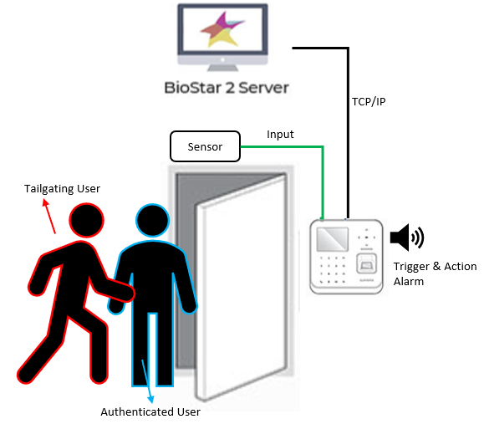
Tailgating
Tailgating, or piggybacking, is the act of following someone through an access control point, instead of using the credentials normally needed to enter.
For example, a user fails to properly log off their computer, allowing an unauthorized user to "piggyback" on the authorized user's session.
Prevention
Always log off from public computers
Avoid logging into sensitive sites using public networks
Avoid physical tailgating through video surveillance

Slide 20
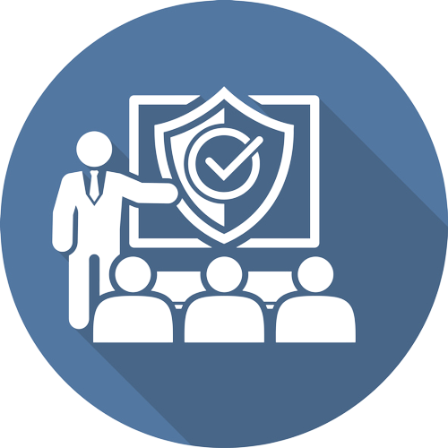
Building Security
Awareness with
Training Programs

Slide 21
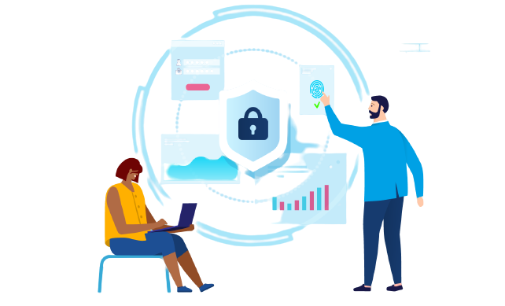
Social Engineering Training
Training users to recognize and respond to social engineering attacks can be an incredibly arduous task because such attacks take advantage of our behavioral norms and tendencies.
Users should be taught to be suspicious of anything that seems unusual
Ask people to trust but verify when faced with even the slightest doubt
Users may flood security operations center with calls and emails, but at least they won’t fall victim.
Teach password hygiene
Create policies regarding social engineering attacks

Slide 22

Passwords Hygiene
Password breaches pose serious security risks.
More than 3 billion passwords end up in the wrong hands each year (through Data Breach)
The most common password is “123456.”
Not to Do
Leaving passwords written in obvious locations
Share them with others
Reuse the same passcode over and over again

Slide 23
Passwords Hygiene
To Do
Use 1 password per account/Service
Use strong passwords: Use long passwords and combine uppercase letters, lowercase letters, numbers, and symbols.
Change your password frequently. Never reuse passwords
Be careful where you enter your password (protect shoulder surfing)
Enable Two-Factor Authentication where required
Password managers can be helpful to store your passwords
Create policies regarding password hygiene

Slide 24
Use of Public Wi-Fi
May not be trustworthy. They could share your information to other companies who operate in countries without any data protection.
You may not know who is watching you whilst you’re online.
What to Do and Not to Do
Don’t access sensitive application from Public Wi-Fi. Use your own data.
Don’t conduct any purchases
Use a virtual private network (VPN)

Slide 25


Personal Equipment Hygiene
To Do
Set rules for when and how employees can use personal equipment in the workplace.
Set guest networks for personal equipment
Educate employees about personal equipment usage and the risks
Communicate that these policies apply to devices such as vendor laptops or mobile devices that can connect to networks.

Slide 26

Clean Desk Policies
A clean desk policy states that no sensitive information should lay unattended on a desk for any significant period of time.
Introduction of such a policy should also entail introduction to the practice of proper disposal of physical media containing sensitive information.

Slide 27
Acknowledgement
https://datareportal.com/reports/digital-2022-bangladesh
(DataReportal is an online reference library offering hundreds of reports packed with data, insights, and trends )
https://dataprot.net/statistics/cyber-security-statistics/
27

Slide 28

Any Questions?
28

Slide 29
Thank you for Listening! For further query please contact me at shafiul[at]du.ac.bd
29

